Slide 1
Mongoose
Schemas and Models | Connecting MongoDB | Finding Documents | Updating and Deleting Documents
Notes:
Welcome to our lecture on Mongoose. In this lecture we will go through schemas and models, connecting MongoDB, finding documents, updating and deleting documents. Let’s start the video lecture.

Slide 2

Schemas and Models
mongodb module lets Node.js interact with MongoDB like the shell.
Mongoose simplifies MongoDB operations with schemas and ODM.
ODM converts database data into JavaScript objects.
Notes:
Schemas and models help manage structured data in a database. A database module allows interaction with stored information, similar to using a command-line interface. Another tool simplifies working with structured records, making it easier to define and enforce rules. Object data mapping converts stored entries into easily managed programming objects for efficient use in applications.

Slide 3
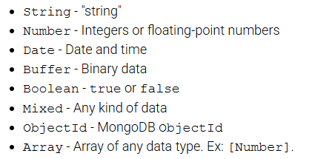
Schemas and Models
Mongoose schemas define document structure using mongoose.Schema(). The supported data types are:
Notes:
Schemas define the structure of stored data, ensuring consistency. They support various data types, including text, numbers, dates, binary data, and true or false values. Some fields can store mixed content, unique identifiers, or lists of values. By defining a structure, schemas help maintain organization, making it easier to interact with and manage database records efficiently.

Slide 4
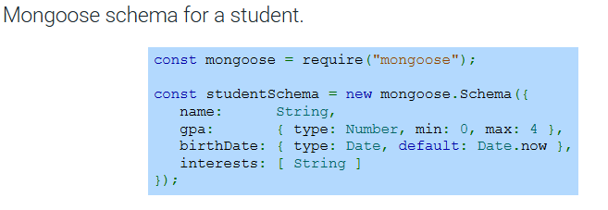
Example
Notes:
Now that we understand the basics, let's look at a real example of how we can define a structure for storing student information. Here, we are creating a format that includes key details such as name, academic performance, date of birth, and interests. We also ensure certain conditions, like setting limits for scores and providing a default value for dates to keep the data organized.

Slide 5
Schemas and Models
Model is a constructor compiled from a schema.
mongoose.model() creates models using a name and schema.
Model instances represent MongoDB documents for saving/retrieval.
Best practice: Capitalize model names (e.g., "Card" instead of "card").
Notes:
Building on our previous example, let’s explore how structured data is used. A model serves as a blueprint that is created from a predefined structure. It allows us to generate objects that interact with the database. These objects can be saved, retrieved, and manipulated efficiently. A best practice is to capitalize model names to maintain consistency and readability.

Slide 6
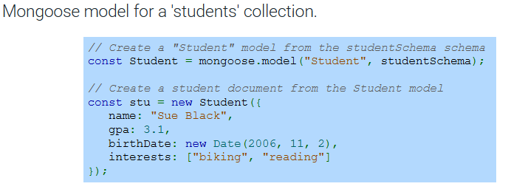
Example
Notes:
Now that we understand how models work, let’s see how they are used in action. Here, we are creating a model from an existing structure to represent student records. Once the model is set up, we can create new student entries with details like name, academic performance, birth date, and interests. This allows for easy organization and retrieval of student data in the database.

Slide 7
Connecting to DB
Mongoose.connect() establishes a connection to MongoDB.
Requires a URL parameter specifying the server and database name.
MongoDB creates the database if it doesn’t exist.
Notes:
To interact with the database, we first need to establish a connection. This is done by specifying a URL that includes the server address and the database name. If the database doesn’t exist, it will be created automatically. This connection allows us to send and retrieve data, ensuring seamless communication between our application and the database.

Slide 8
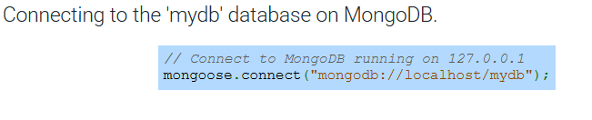
Example
Notes:
In this example, we are connecting to a local database named "mydb" running on the server. The connection URL specifies the server address and database name. This ensures that our application communicates with the correct database, and if it doesn't exist, it will be automatically created to handle the data operations seamlessly.

Slide 9
Saving Documents
save() saves a document and returns a Promise.
create() saves one or multiple documents.
Both methods return Promises resolving to saved documents.
Notes:
When saving data, there are two main methods available. The first allows saving a single document and returns a promise indicating the success or failure of the operation. The second method is used when saving one or more documents at once. Both methods return promises that resolve once the data has been successfully saved, ensuring smooth data handling.

Slide 10
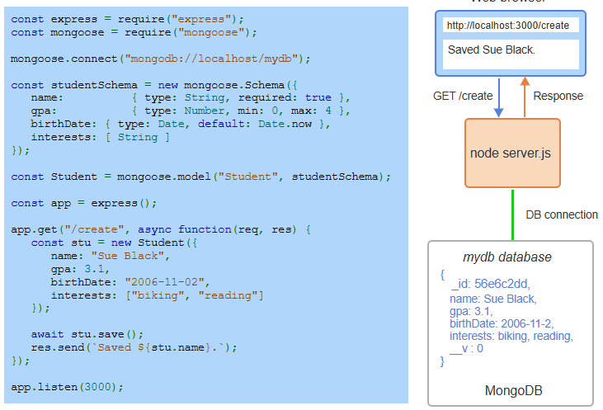
Example
Notes:
In this example, we are setting up a simple web server that connects to a local database. When a user accesses a specific route, the server creates a new student record and saves it to the database. Once the data is saved, a response is sent back confirming the saved student’s name. This process demonstrates the connection between the server, the database, and the web interface.

Slide 11
Finding Documents
find() retrieves multiple documents.
findOne() retrieves a single document.
Supports MongoDB query operators like $in and $gt.
Notes:
Now that we've seen how to save data, let’s move on to retrieving it. To fetch data from the database, there are two main methods. The first allows us to fetch multiple records at once, while the second method is used to retrieve a single record. Both methods support special operators for more advanced queries, enabling flexible and precise searching based on various conditions within the data.

Slide 12
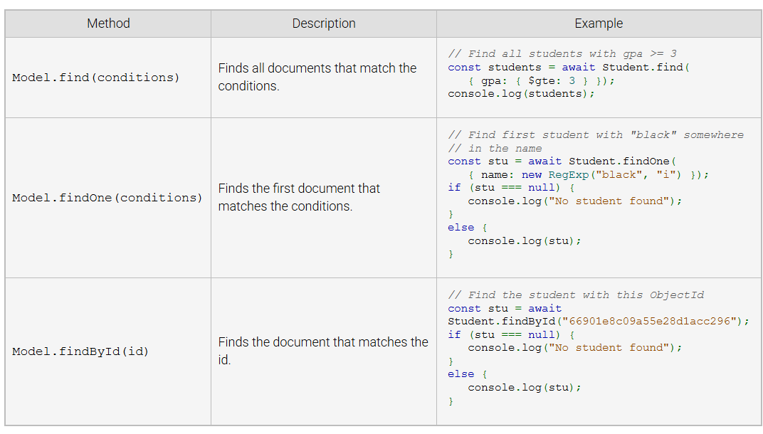
Common Mongoose Find Method
Notes:
Now that we know how to retrieve data, let’s look at some common methods for finding documents. The first method fetches all records that meet certain conditions. The second method returns the first document that matches the criteria. Finally, the third method allows us to search for a document by its unique identifier, ensuring precise retrieval.

Slide 13
Finding Document Methods
All Mongoose find methods return a Query object. The Query object has a number of methods that may be chained to create a more readable query. Example methods include:
The Query.where() method specifies a path to filter documents.
The Query.sort() method sets the sort order.
The Query.limit() method limits the number of documents returned.
The Query.exec() method is called last to execute the query and returns a Promise that resolves to the matching documents.
Notes:
Now that we understand the basic methods for finding documents, let’s explore how to refine our queries. Mongoose provides a query object that allows us to chain various methods for better control and readability. These methods let us filter, sort, limit the number of results, and finally, execute the query to retrieve the matching documents.

Slide 14
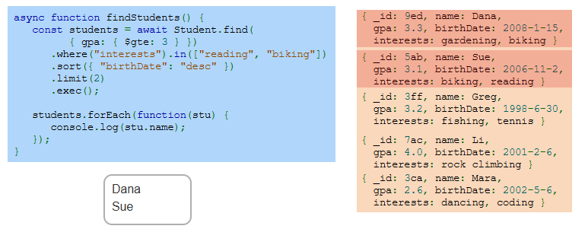
Example
Notes:
In this example, we are finding students who meet specific conditions. We filter by GPA, ensure they have certain interests, sort by birth date in descending order, and limit the results to two entries. The output shows only the students who meet all criteria, allowing us to retrieve the relevant data efficiently and neatly.

Slide 15
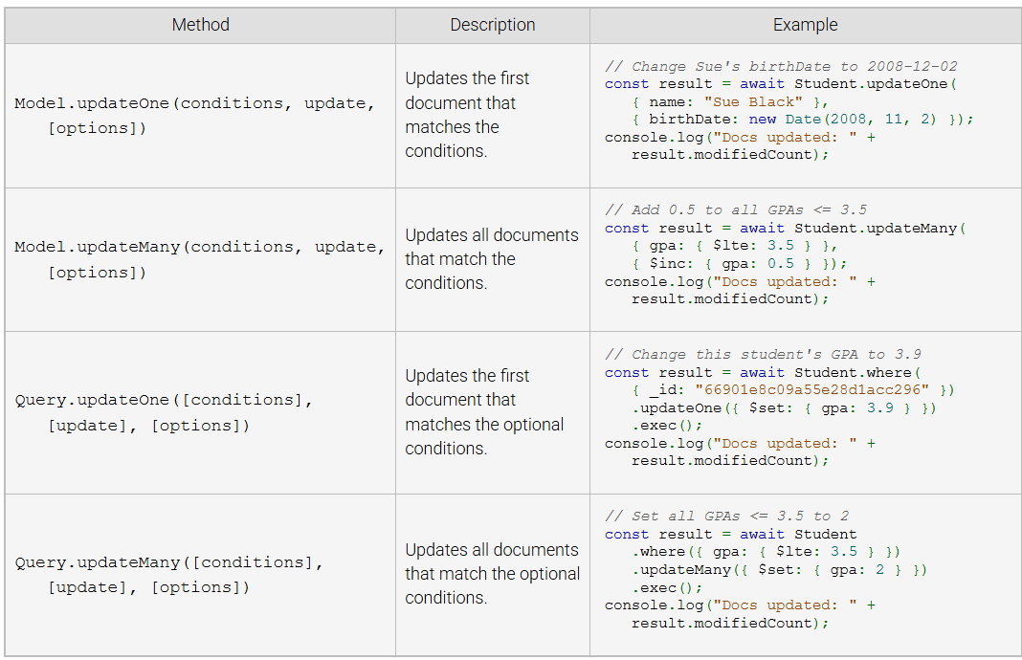
Common Mongoose Update Method
Notes:
Now that we've seen how to find documents, let’s look at how we can update them. There are several methods for updating data. The first allows you to update a single document that matches a condition, while the second method updates all documents matching the condition. These methods give flexibility in choosing whether to update just one or multiple entries based on your needs.

Slide 16
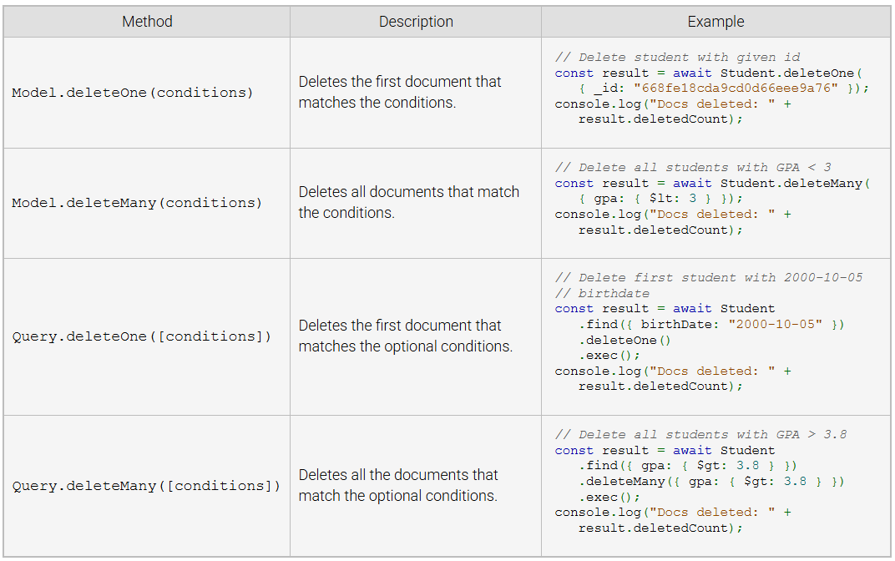
Common Mongoose Delete Method
Notes:
Moving on to deleting documents, we have a few different methods to remove data. The first method deletes a single document that matches a condition, while the second method deletes all documents that meet the specified criteria. These deletion methods help manage your database by removing unnecessary or outdated entries as needed.

